Slide 1

MySQL
Course Introduction
SoftUni Team
Technical Trainers
Software University
https://softuni.bg

Slide 2
Table of Contents
Course Objectives & Program
The Trainers Team
Course Organization
Homework
Exam
Resources

Slide 3
Have a Question?
sli.do #java-db

Slide 4











SoftUni Diamond Partners

Slide 5


Educational Partners

Slide 6

Database Basics
Course Objective & Program

Slide 7
Course Objectives
The MySQL course provides
Basic database and query concepts
Establishes fundamentals for further DB trainings
Content: SQL syntax, data types, programmability
What is NOT covered?
Client-side implementations
API Libraries

Slide 8



Course Topics
Introduction to Databases. Data Definition and Datatypes
Basic CRUD, intro to SQL
Built-in functions
Data aggregation
Table Relations
Subqueries and JOINs
Functions, Triggers, Transactions

Slide 9

The Trainers Team

Slide 10
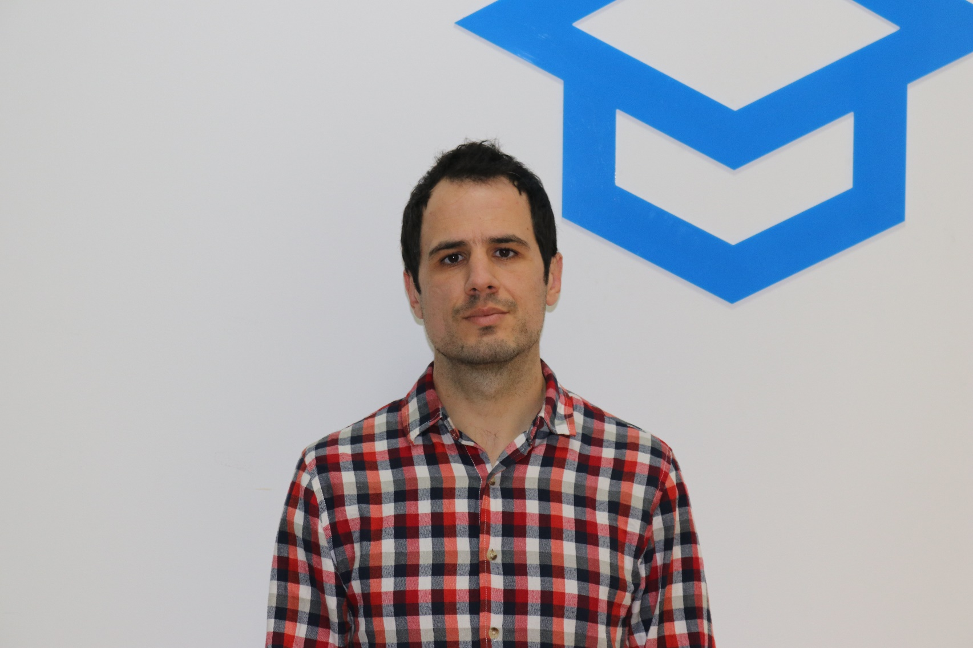
Veselin Vachev
Team Lead @ Netinfo
9 years full-stack web developer
Back-end / front-end, SEO, UX
Making CD / CI Systems
Current projects: Gong.bg, Nova.bg, Dariknews.bg, Vesti.bg, Sinoptik.bg

Slide 11

Nikolay Markov
Technical Trainer @ SoftUni
Java Developer @ Playtech Bulgaria
Top Student @ SoftUni
Experience with Java, JavaScript,
TypeScript and Angular
Plays basketball and billiard
in his spare time
Interested in books, movies and comics

Slide 12

Course Organization

Slide 13
Java DB Module – Timeline
11-Jan-2022
15-Feb-2022
02-Apr-2022
17-Apr-2022
MySQL
4 weeks * 4 times / week
12 credits
Start: 11-Jan-2022 Final exam: 13-Feb-2022
Spring Data
7 weeks * 4 times / week
15 credits
Start: 15-Feb-2022
Final exam: 02-Apr-2022
Re-Take Exams MySQL 10-Apr-2022 Spring Data 17-Apr-2022

Slide 14


SoftUni Certificate
Practical Exam 100%
Homework 5%
Evaluation
14

Slide 15
CPE Certificate
Practical Exam
Theoretical Exam
Evaluation
15

Slide 16

Homework Assignments & Exercises
Your homework is mainly work in class!
Lesson days → slides + live demos + exercises
Exercise days → only exercises
How to submit your homework?
Submitted in the judge system
Do your homework when it's due!
Assignments pile up quickly

Slide 17
Exam
Section 0: Database Overview
You are given an Entity / Relationship Diagram of some Database
Section 1: Data Definition Language (DDL)
Data Types, Constraints
Section 2: Data Manipulation Language (DML)
Insert, Update, Delete

Slide 18
Exam
Section 3: Querying
Data Extraction
Section 4: Programmability
Functions and Procedures

Slide 19
Resources
What We Need Additionally?

Slide 20



Java DB Course Web Site and Forum
Official web site:
Official discussion forum:
Official Facebook group:
https://softuni.bg/trainings/3602/mysql-january-2022
https://softuni.bg/forum/categories/77/databases-basics-mysql
https://www.facebook.com/groups/JavaDBJanuary2022/

Slide 21


The DB Basics MySQL Slides and Videos
All lecture slides, videos, homework assignments, projects and other resources are open content, available for free
Visit the course web site to access the course resources

Slide 22

Java DB Recommended Software
Software needed for this course:
Microsoft Windows 10
Workbench - https://dev.mysql.com/downloads/workbench/

Slide 23

Learn to Search in Internet
The course assignments require to search in Internet
This is an important part of the learning process
Some exercises intentionally have no hints
Learn to find solutions!
Software development includes everyday searching and learning
No excuses, just learn to study!
Developers learn new technologies, tools, languages every day!

Slide 24
Questions?
Notes:
24

Slide 25
Trainings @ Software University (SoftUni)
Software University – High-Quality Education, Profession and Job for Software Developers
softuni.bg, about.softuni.bg
Software University Foundation
softuni.foundation
Software University @ Facebook
facebook.com/SoftwareUniversity
Software University Forums
forum.softuni.bg
Notes:
25

Slide 26

License
This course (slides, examples, demos, exercises, homework, documents, videos and other assets) is copyrighted content
Unauthorized copy, reproduction or use is illegal
© SoftUni – https://about.softuni.bg/
© Software University – https://softuni.bg
Notes:
26

